Slide 1
Modeling EP/Cath shared room use
EP Physician office space
Patient family waiting area
Detailed volume changes
Model volume change scenarios
Procedure Room Use
Pre and post procedure use

Slide 2
EP Physician office space
Two additional physicians:
Patient family waiting area
Estimates of use:

Slide 3
Modeling Cath Volume Decrease
Procedure Catagorization | 2009 | 2010 | 2011 | 2012 | 2013 | JanSep 2014 | Estimate 2014 | Yearly change based on 2009 - 2014
Cors Only | 1004 | 1202 | 1356 | 1489 | 1462 | 1152 | 1536 | 77
RHC | 451 | 611 | 640 | 661 | 719 | 607 | 809 | 48
Dx Cath | 1517 | 1373 | 1217 | 994 | 931 | 606 | 808 | -142
Cors to IV | 772 | 727 | 717 | 711 | 647 | 483 | 644 | -24
Other | 1019 | 983 | 903 | 759 | 672 | 405 | 540 | -112
RHC and Biopsy | 461 | 349 | 318 | 277 | 343 | 266 | 355 | 4
Dx to IV | 453 | 357 | 363 | 317 | 340 | 245 | 327 | -8
Valve | 122 | 135 | 113 | 99 | 130 | 97 | 129 | 1
ASD,VSD,PDA Closure | 132 | 98 | 80 | 59 | 65 | 56 | 75 | -6
Dx and Biopsy | 152 | 141 | 88 | 73 | 79 | 56 | 75 | -14
Aborted | 23 | 35 | 65 | 33 | 30 | 28 | 37 | -3
IV | 106 | 133 | 66 | 82 | 44 | 24 | 32 | -22
IABP Only | 33 | 42 | 41 | 40 | 24 | 21 | 28 | -5
Congenital Diagnostic | 13 | 5 | 14 | 21 | 23 | 15 | 20 | 4
NoLabel | 0 | 0 | 0 | 0 | 0 | 2 | 3 | 1
IV And Valve | 2 | 7 | 7 | 4 | 17 | 2 | 3 | 0
Remove all TAVR procedures slated to leave the Cath lab. Project three scenarios:
Flat case: Volume remains at current levels for 4 years.
Stable case: Volume drop stabilizes at 5,200 after for 4 years. Approximately 50 procedure drop per year.
Linear case: Volume drops to 5,000 after for 4 years. Approximately 100 procedure drop per year.
In Model: A drop of 50 (100) procedures per year corresponds to a drop of 22 (43) procedures per 6 months of prime time.
* Apollo data 2004-2014

Slide 4
Modeling potential for EP Volume Growth
 | Total | ablation | pacemaker implant | ICD implant | pacemaker implant/replacement | ICD implant/replacement | pacemaker replacement | CRT | EP study
Additional operator | 111 | 58 | 16 | 6 | 6 | 1 | 4 | 6 | 8
% of total | 100% | 52% | 14% | 5% | 5% | 1% | 4% | 5% | 7%
Physician | % of total | Total | ablation | pacemaker implant | ICD implant | pacemaker implant/replacement | ICD implant/replacement | pacemaker replacement
1 | 20% | 144 | 14 | 33 | 22 | 13 | 11 | 9
2 | 18% | 133 | 118 | 2 | 1 | 1 | 0 | 0
3 | 15% | 111 | 58 | 16 | 6 | 6 | 1 | 4
4 | 11% | 77 | 28 | 14 | 6 | 6 | 4 | 1
5 | 8% | 60 | 3 | 24 | 5 | 8 | 4 | 1
6 | 8% | 56 | 3 | 13 | 9 | 3 | 5 | 7
7 | 7% | 52 | 2 | 15 | 4 | 5 | 3 | 6
8 | 6% | 47 | 0 | 19 | 7 | 0 | 5 | 2
9 | 5% | 33 | 0 | 11 | 6 | 3 | 3 | 3
10 | 2% | 18 | 18 | 0 | 0 | 0 | 0 | 0
Total | 100% | 731 | 244 | 147 | 66 | 45 | 36 | 33
% of total |  | 100% | 33% | 20% | 9% | 6% | 5% | 5%
* Apollo data 2004-2013 + Apollo data Jan – May 2014
Notes:
Moussa
Non-Clinical Space: Creates a difficult working environment and poses safety/compliance problems.
Growth: National trends suggest opportunity for growth in outpatient ablation procedures.
MGH is well positioned to perform more ablations and more lead extractions
Goal: 300 additional ablations & 100 additional lead extractions per year

Slide 5
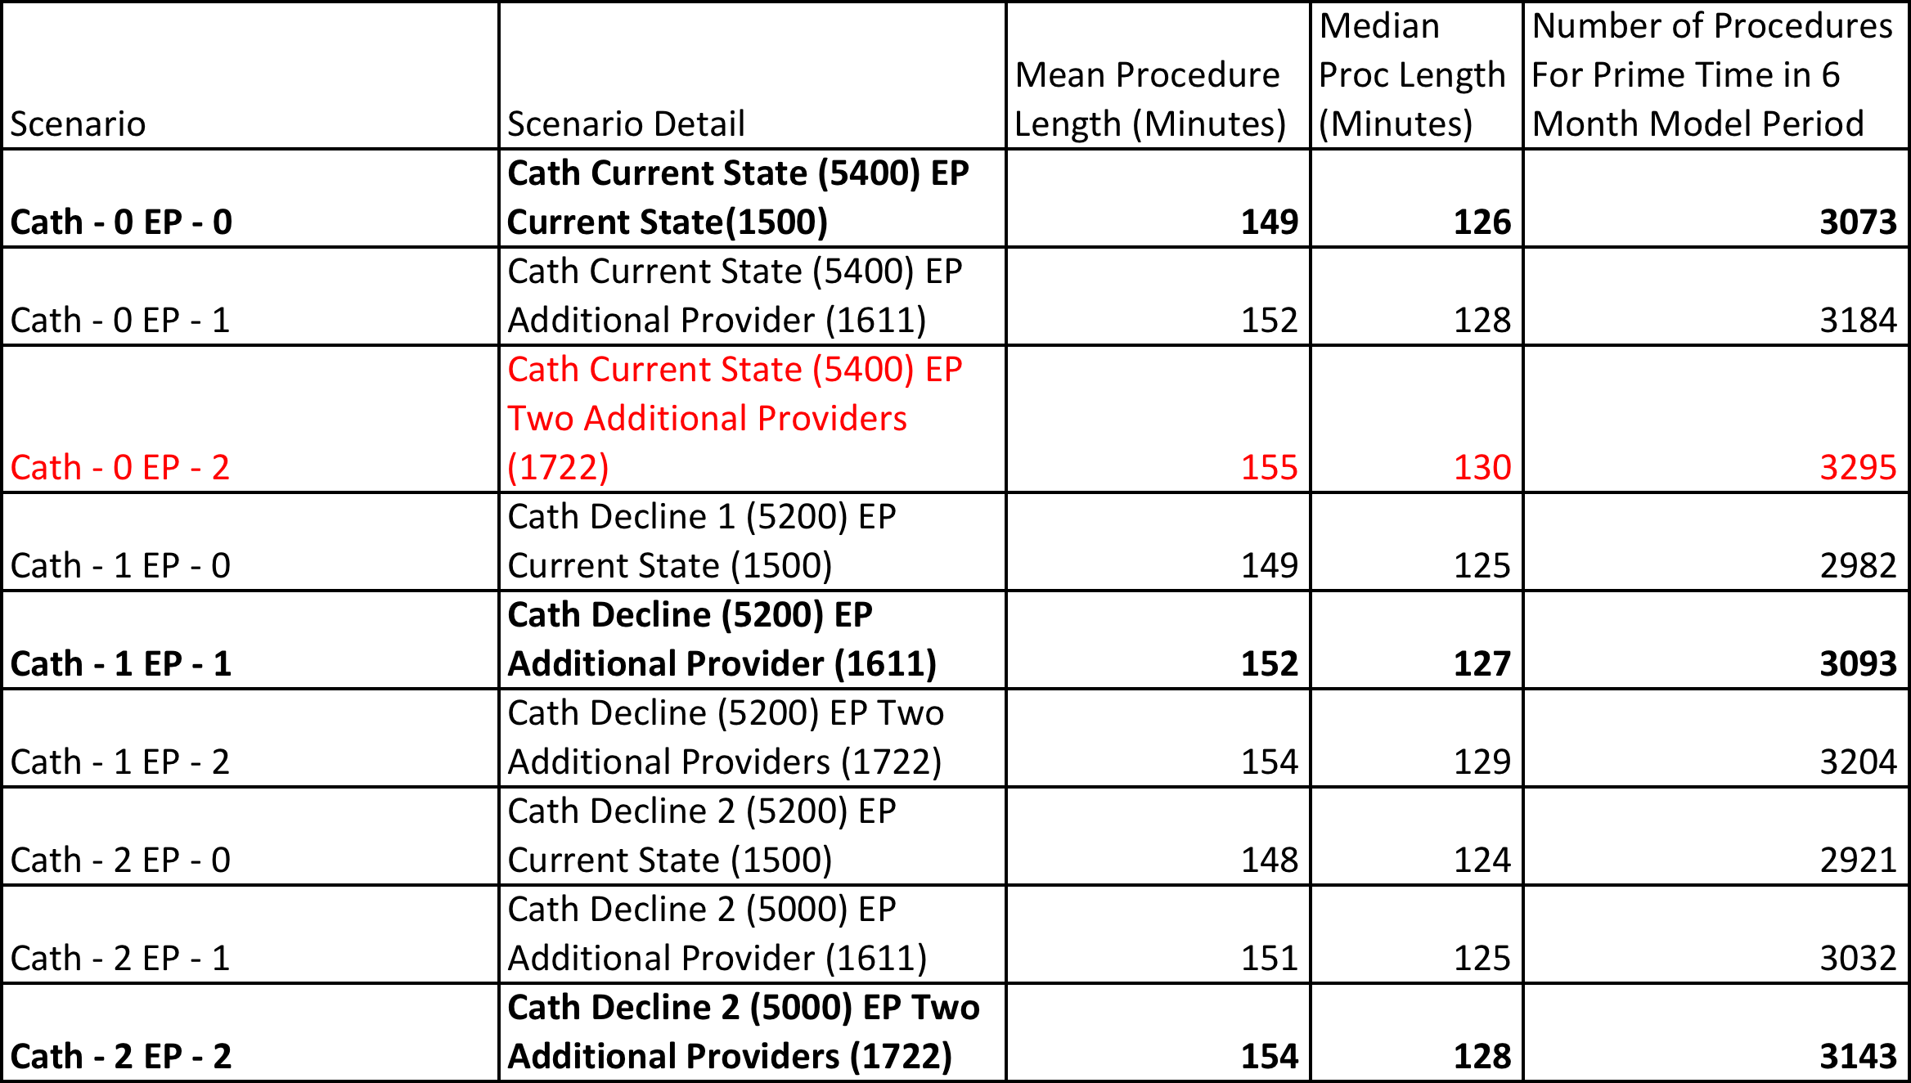
Model scenarios for potential for EP/Cath Volume Change
Baseline: Data from Jan-Jun 2013. Total number of procedures modeled = 3,073 (Cath – 2,342, EP – 731*)
Apollo data 2004-2013 + Apollo data Jan – May 2014
Excludes non-invasive EP procedures currenty performed in the middle room: tilt-table, cardioversion, drug study
Notes:
Moussa
Non-Clinical Space: Creates a difficult working environment and poses safety/compliance problems.
Growth: National trends suggest opportunity for growth in outpatient ablation procedures.
MGH is well positioned to perform more ablations and more lead extractions
Goal: 300 additional ablations & 100 additional lead extractions per year

Slide 6
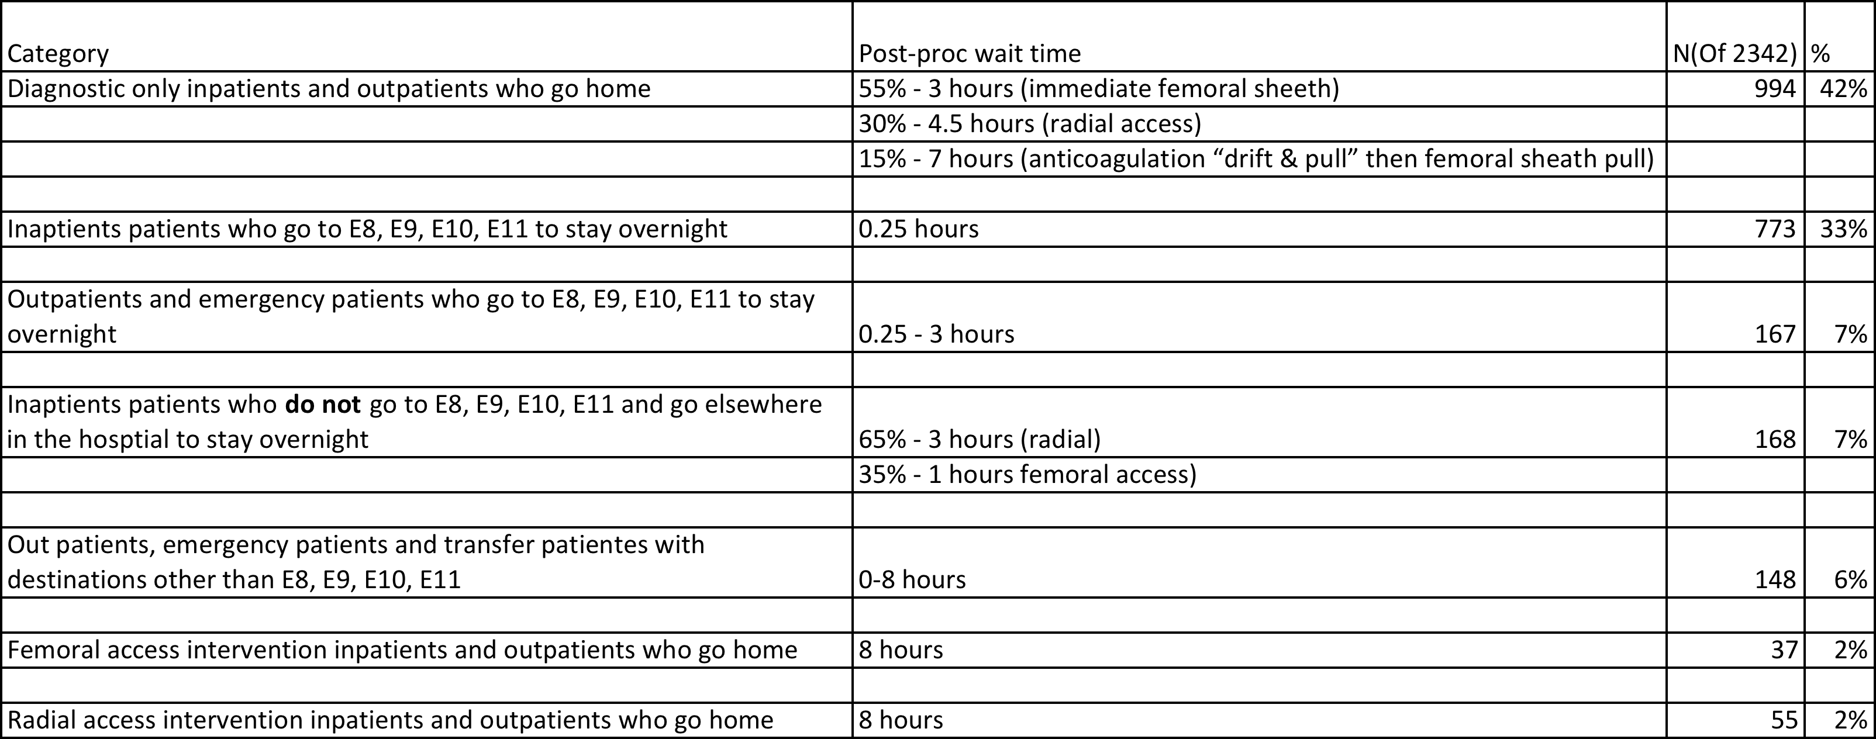
Cath patient Pre and Post procedure room use
Weighted average is 2.65 hours
Apollo data 2004-2014
Prism PACU data 2013-2014

Slide 7
EP patient Pre and Post procedure room use
Procedure as we'll label it | Post procedure time in recovery room before giong to a hospital bed or going home | Freq
Ablation | Ready for inpatient bed after 3 hours | 244
Primary pacemaker implant | Ready for inpatient bed after 30min - 2hrs | 147
Primary ICD implant | Ready for inpatient bed after 30min - 2hrs | 66
Pacemaker/ICD Upgrade | Ready for inpatient bed after 30min - 2hrs | 45
Pacemaker/ICD Upgrade | Ready for inpatient bed after 30min - 2hrs | 36
Gen change | Go home after 1.5 hours | 33
CRT | Until bed ready (30min - 2hrs) | 30
EP study (negative) | Go home after 4-6 hours | 25
ICD replacement | Go home after 1.5 hours | 22
event recorder implant | Outpatient < 60min | 21
lead replacement/revision | Until bed ready (30min - 2hrs) | 15
lead insertion | Until bed ready (30min - 2hrs) | 9
event recorder removal | Outpatient < 60min | 5
Fluoroscopy | Outpatient < 60min | 5
Apollo data 2004-2014
Prism PACU data 2013-2014

Slide 8
Modeling Recovery Bay Use: Overview of Scenarios
Scenario | Cath Rooms | EP Rooms | Cath Volume Changes | EP Volume Changes | Scheduling Algorithm
X (can be modeled) | 5 / 6 | 3 / 4 | Flat / 1 Year Drop / 2 Year Drop | Flat / 1 Year Growth / 2 Year Growth | Longest procedures / Shortest procedures / Longest recovery time procedures first
A | 5 | 3 | Flat | 2 Year Growth | Longest procedures scheduled first
B | 5 | 3 | Flat | 2 Year Growth | Shortest procedures scheduled first
C | 5 | 3 | Flat | 2 Year Growth | Longest recovery time procedures scheduled first

Slide 9
Scenario | Cath Rooms | EP Rooms | Cath Volume Changes | EP Volume Changes | Scheduling Algorithm
A | 5 | 3 | Flat | 2 Year Growth | Longest procedures scheduled first
Holding Bay Occupancy: 25 Week Summary
# Holding Bays Occupied

Slide 10
Scenario | Cath Rooms | EP Rooms | Cath Volume Changes | EP Volume Changes | Scheduling Algorithm
B | 5 | 3 | Flat | 2 Year Growth | Shortest procedures scheduled first
Holding Bay Occupancy: 25 Week Summary
# Holding Bays Occupied

Slide 11
Scenario | Cath Rooms | EP Rooms | Cath Volume Changes | EP Volume Changes | Scheduling Algorithm
C | 5 | 3 | Flat | 2 Year Growth | Longest recovery time procedures scheduled first
Holding Bay Occupancy: 25 Week Summary
# Holding Bays Occupied

Slide 12
Cath and EP recovery bay use over 25 weeks
Highest volume scenario: Cath volume flat, EP two additional providers, 5 Cath rooms, 4 EP rooms
Comparison of scenarios for total number of patients left at end of day over 25 weeks

